Slide 1
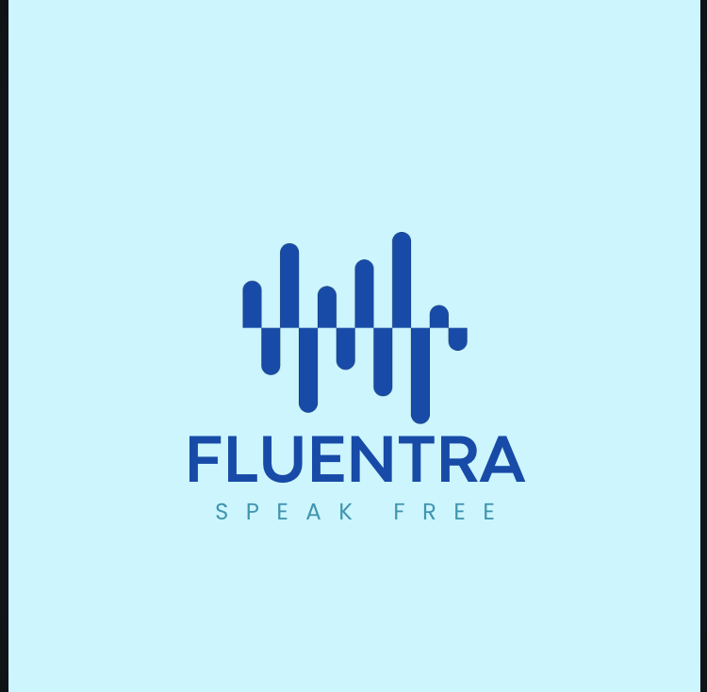

Project Proposal
Project Title: FLUENTRA
Final Year Project
BS COMPUTER SCIENCE
FALL 2025

Slide 2
PROJECT TEAM
Student ID | Student Name | Program | E-mail
 |  | COMPUTER SCIENCE | students.riphah.edu.pk
 |  | COMPUTER SCIENCE | @students.riphah.edu.pk
Supervisor(s) Name | Designation | E-mail
Ms. ZARMINA JAHANGIR | Senior Lecturer | @riphah.edu.pk
Ms. ZULLATUN GUL | Lecturer | @riphah.edu.pk

Slide 3
AGENDA
Introduction
Problem Statement
Existing System / Competitive Analysis
Proposed Solution
Sustainable Development Goal Mapping
Project Scope/ Project Features
System Architectural Design
Implementation Tools and Techniques
Prototype / Report

Slide 4
Introduction
Stuttering is a speech disorder that disrupts the normal flow of speaking.
It usually starts in early childhood and may continue into adulthood.
Causes include genetic, neurological, developmental, psychological, and environmental factors.
It affects a person’s communication, confidence, and social interaction.
Types of Stuttering
Repetitions – repeating sounds, syllables, or words.
Prolongations – stretching a sound.
Blocks – pauses or inability to produce a sound.
Interjections – adding extra sounds or words (e.g., um, uh).

Slide 5
Problem Statement
Stuttering and speech dysfluencies disrupt fluent communication, causing reduced confidence, social anxiety, and emotional challenges. Current speech therapy methods are costly, time-consuming, and not easily accessible. Most existing apps lack real-time detection, personalized feedback, and progress tracking

Slide 6
Proposed Solution
The proposed solution, FluEntra, is an AI-powered software application that provides real-time stuttering analysis and intervention. Users can record their speech, which is processed by an AI model to detect and classify dysfluencies such as blocks, prolongations, and repetitions. The system delivers immediate visual feedback through highlighted transcripts, event tables, and a dynamic fluency score. Based on this analysis, FluEntra suggests personalized exercises tailored to the user’s frequent stutter patterns. A dedicated Therapist Mode offers detailed progress reports, enabling therapists to track clients remotely and support data-driven, accessible speech therapy.

Slide 7
Features
Core Features
Stutter Type Classification: Real-time classification of detected stutters into the following categories:
  Block
  Prolongation
  Sound Repetition
  Word Repetition
  Interjection (e.g., uh, um)
Voice Recording: Simple and intuitive interface – users can start and stop speech recording easily.
Probability Score: Displays the confidence level of detection

Slide 8
2. Voice Enhancement
Background Noise Cancellation: Removes environmental and background sounds for clearer speech input.
Microphone Distortion Removal: Enhances audio clarity by reducing microphone distortions, ensuring accurate analysis.
3. Analysis and Feedback Features
Window-Based Segmentation (0.5–1 sec): Detects precise stutter events within short, fixed time intervals.
Transcript Highlighting: Automatically highlights stuttered or dysfluent words within the generated transcript.
Event Table: Displays a structured report for each stuttering event including:
| Start (s) | End (s) | Type | Probability | Word(s) |
Fluency Score (0–100): Calculates a dynamic fluency score based on the ratio of fluent to stuttered speech.
Pause Detection: Differentiates between natural pauses and abnormal silent blocks.
Duration Measurement: Calculates the duration of blocks and prolongations (in seconds) for detailed analysis.

Slide 9
4. Therapy and Exercise Features
Personalized Exercises: AI recommends targeted exercises based on detected stutter types:
  Block → Smooth onset drills
  Prolongation → Breathing and pacing exercises
  Repetition → Controlled speech drills
  Interjection → Filler-word reduction games
Therapist Mode:
  Enables therapists to access detailed client reports.
  Allows professionals to provide custom feedback and tailor training sessions remotely.
5. Tracking and Progress Features
Daily Progress Graphs: Visual representation of user improvement trends over time.
Stutter Type Distribution: Pie charts showing percentage breakdown of stutter types (e.g., % Block, % Repetition, % Prolongation).
Long-Term Analytics: Tracks consistency, relapse patterns, and overall fluency development in an organized and data-driven way.

Slide 10
Elicitation Techniques Used
To gather requirements for the FluEntra system, the following requirement-elicitation techniques used:
Interviews
Participants:
Speech Therapists
Patients with stuttering
AI/ML
Purpose:
To understand therapy workflow, patient struggles, and therapist expectations.

Slide 11
Elicitation Techniques / Tools Used
Market / Literature Survey
Studied existing applications:
Stamurai
Eloquent
StutterStars
VoiceIt
Linguist
Purpose:
Identify gaps like lack of real-time detection, missing personalized therapy, limited analytics, etc.

Slide 12
Elicitation Techniques / Tools Used
Observation
Watched recorded speech-therapy sessions to understand:
Common stuttering patterns
Timing and behaviour of dysfluencies
Therapist correction strategies
Questionnaire / Feedback Forms
Collected feedback from:
Students with speech issues
Clinical professionals
Web app users

Slide 13
Elicitation Techniques / Tools Used
Wireframing / Prototyping
Developed low-fidelity UI mockups for:
Voice recording screen
Real-time analytics dashboard
Transcript highlighting
Therapist portal

Slide 14
Specification / Documentation
Product Scope
For people with stuttering & therapists
Real-time stutter detection
Fluency scoring & stuttered-word highlighting
Progress reports & exercises
Noise cancellation
Uses ML/DL with English datasets
Needs internet; not a full therapist replacement
Web-based app

Slide 15
Specification / Documentation
Intended Audience and Reading Suggestions
People with stuttering
Speech therapists
Parents/caregivers
Speech/ML researchers
AI Web developers

Slide 16
Specification / Documentation
System User
Primary Users
  Individuals with stuttering or fluency disorders
  Need an easy-to-use interface and guided speech practice
  Will use the system for daily speech exercises and feedback
Operating Environment.
Frontend:
Web-based interface built using ReactJS, HTML, CSS, and JavaScript
Compatible with modern browsers (Chrome, Edge, Firefox, Safari)

Slide 17
Specification / Documentation
Machine Learning Backend:
Python-based stuttering detection model (e.g., PyTorch/TensorFlow)
Served through a REST API (Flask / FastAPI)
Database:
Firebase or MongoDB / PostgreSQL (depending on system structure)
Hosting/Deployment:
Cloud hosting such as Firebase Hosting, AWS, or Render / Vercel
Networking:
Stable internet connection required for speech processing and progress sync
Devices Supported:
Desktop, Laptop, Tablet, and Mobile Browsers

Slide 18
Functional Requirements
Voice Capture (Record & Upload)
● User clicks Record → system requests microphone permission → system shows recording timer → user clicks Stop → system uploads the audio and shows “Processing” status.
● User selects Upload → chooses audio file → system validates format and size → system uploads file and shows “Processing” status.
● User cancels recording → system discards temporary file and returns to dashboard.
The system shall allow registered users to record audio via the web dashboard using the device microphone.
The system shall request and handle browser microphone permissions securely and show appropriate user feedback if permission is denied.
The system shall allow users to upload audio files up to a configurable maximum size (TBD).
The system shall validate uploaded files for audio format and integrity and return descriptive error messages on invalid input.
The system shall create a Recording entry (status = uploaded) in the database immediately after successful upload or end of recording.
The system shall provide a visible processing status and progress indicator on the dashboard while the recording is analyzed.

Slide 19
Functional Requirements
Dysfluency Detection & Classification
● The system shall detect dysfluency events in a recording and return a list of events with type, start time, end time, and confidence score.
● The system shall classify events into at least: Block, Sound Repetition, Word Repetition, Prolongation, and Interjection.
● The system shall support configurable detection sensitivity (threshold) and return results annotated with model confidence.
● The system shall provide per-segment (e.g., 0.5–1s windows) predictions to support fine-grained highlighting.
● System receives preprocessed audio -> feature extraction -> model predicts events -> system returns a list of detected events with start and end times and confidence.
● User requests re-analysis with adjusted sensitivity -> system re-runs detection with the new threshold and updates the report.

Slide 20
Non-Functional Requirements
The speech analysis engine shall maintain an accuracy rate in detecting stuttering or disfluencies based on trained models.
The feedback and progress dashboard shall be updated following completion of analysis or exercises.
The system shall not provide any medical diagnosis or clinical treatment suggestions; it will serve as an assistive educational tool only.
All AI-generated suggestions shall include a disclaimer recommending consultation.
All communication between the client and server shall be protected using encryption.
User audio recordings and analysis results shall be stored in encrypted format in the database.
Performance Requirements
Safety Requirements
Security Requirements

Slide 21
Non-Functional Requirements
Software Quality Attributes
Usability: The interface shall be intuitive and visually accessible for users of all ages, with clear icons and feedback indicators.
Reliability: The system shall ensure 99% uptime under stable hosting conditions.
Scalability: The backend shall support seamless integration with cloud services (e.g., AWS or Firebase) for handling larger datasets.
Security: The system shall ensure end-to-end encryption of user data and adhere to
least-privilege principles.
Performance: AI model inference shall be optimized for low-latency responses using pre- trained lightweight models.
Accessibility: The app shall include basic accessibility support such as voice control, readable fonts, and clear color contrasts.

Slide 22
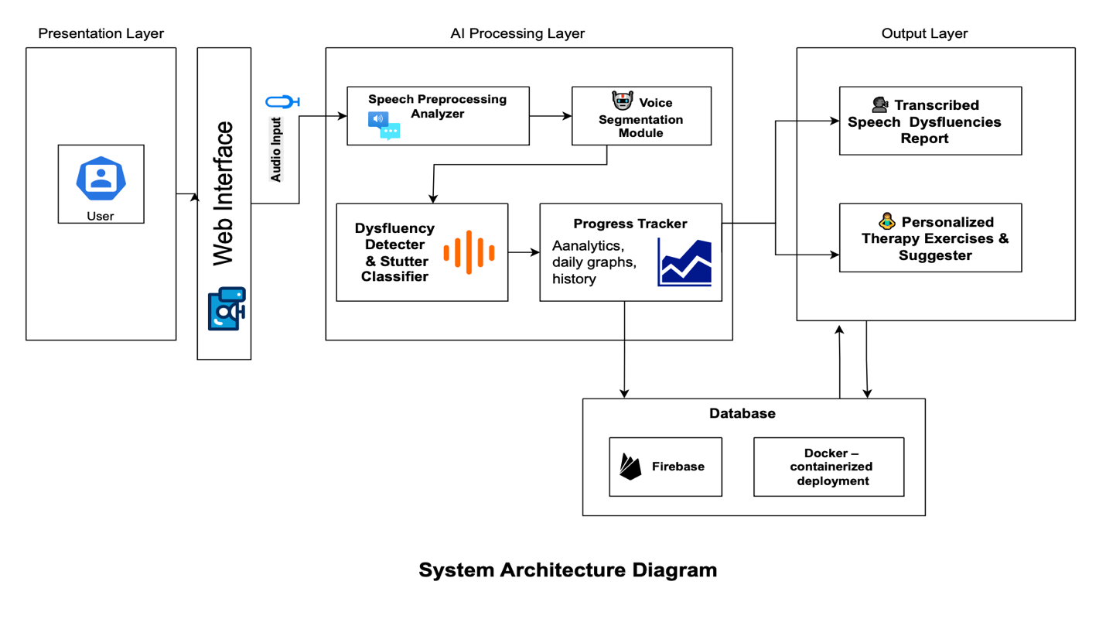
System Architectural Design
Figure 1: Layered Architecture Diagram

Slide 23
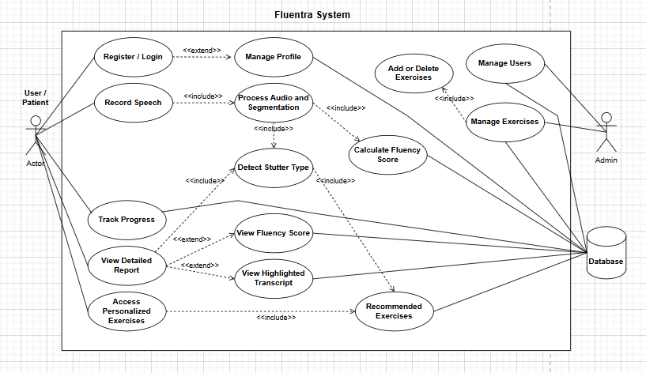
Use Case Diagram
Figure 2: Use Case Diagram

Slide 24
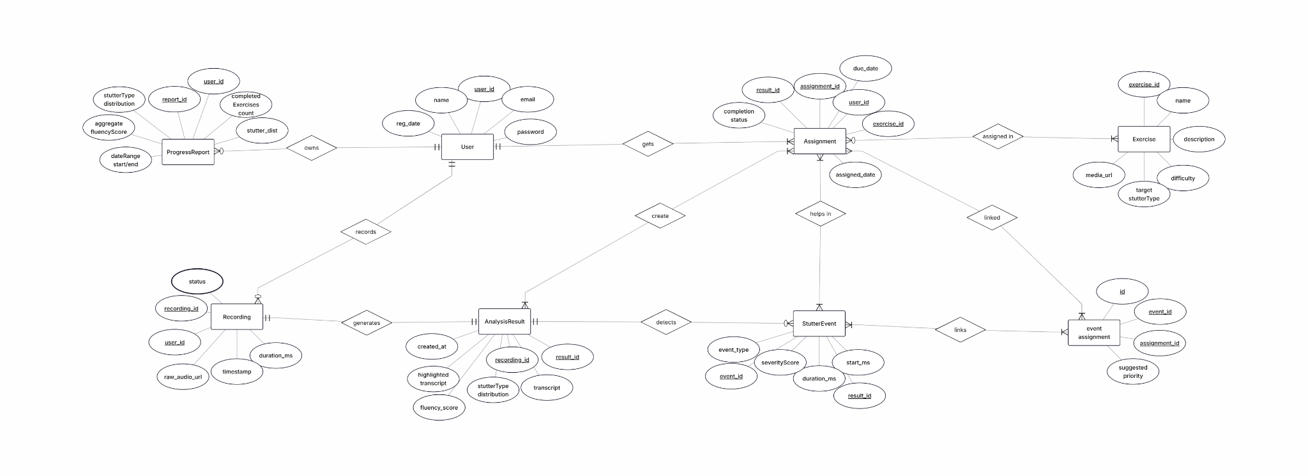
ERD Flow
Figure 4: ERD Flow

Slide 25
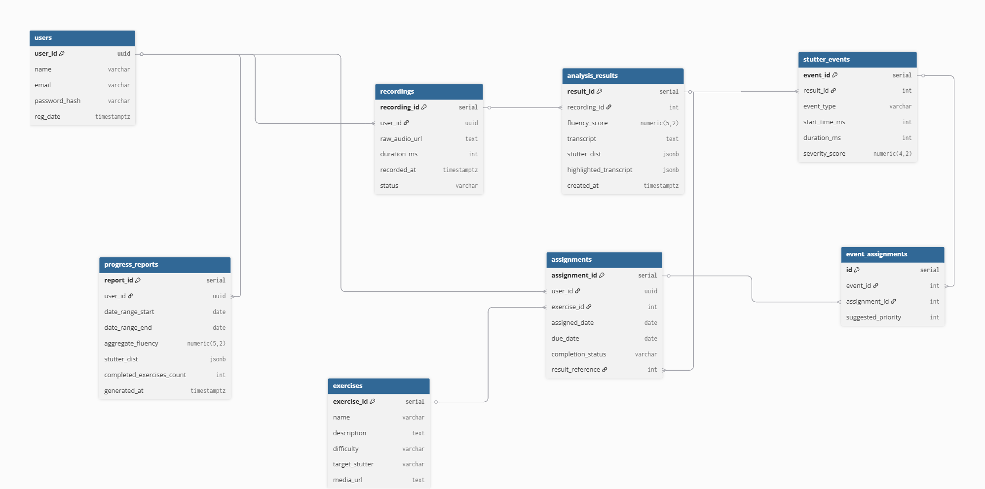
Entity Relationship Diagram
Figure 3: Entity Relation Diagram

Slide 26
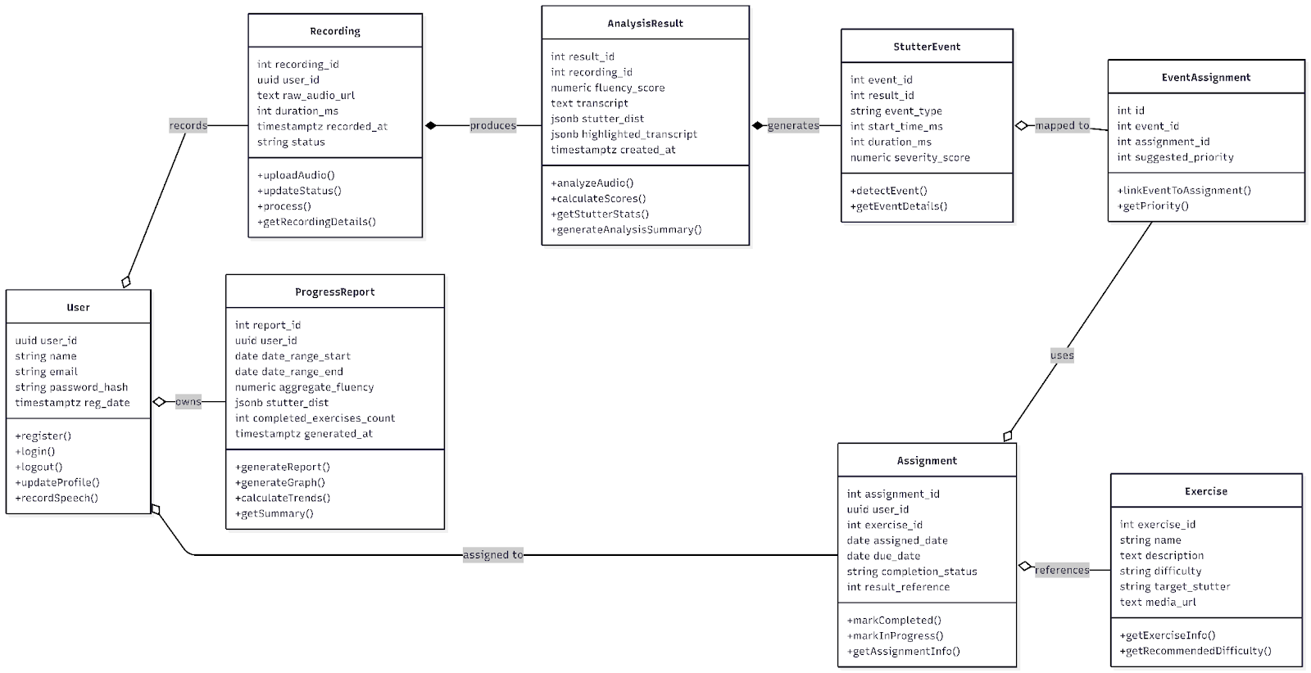
Class Diagram
Figure 5: Class Diagram

Slide 27
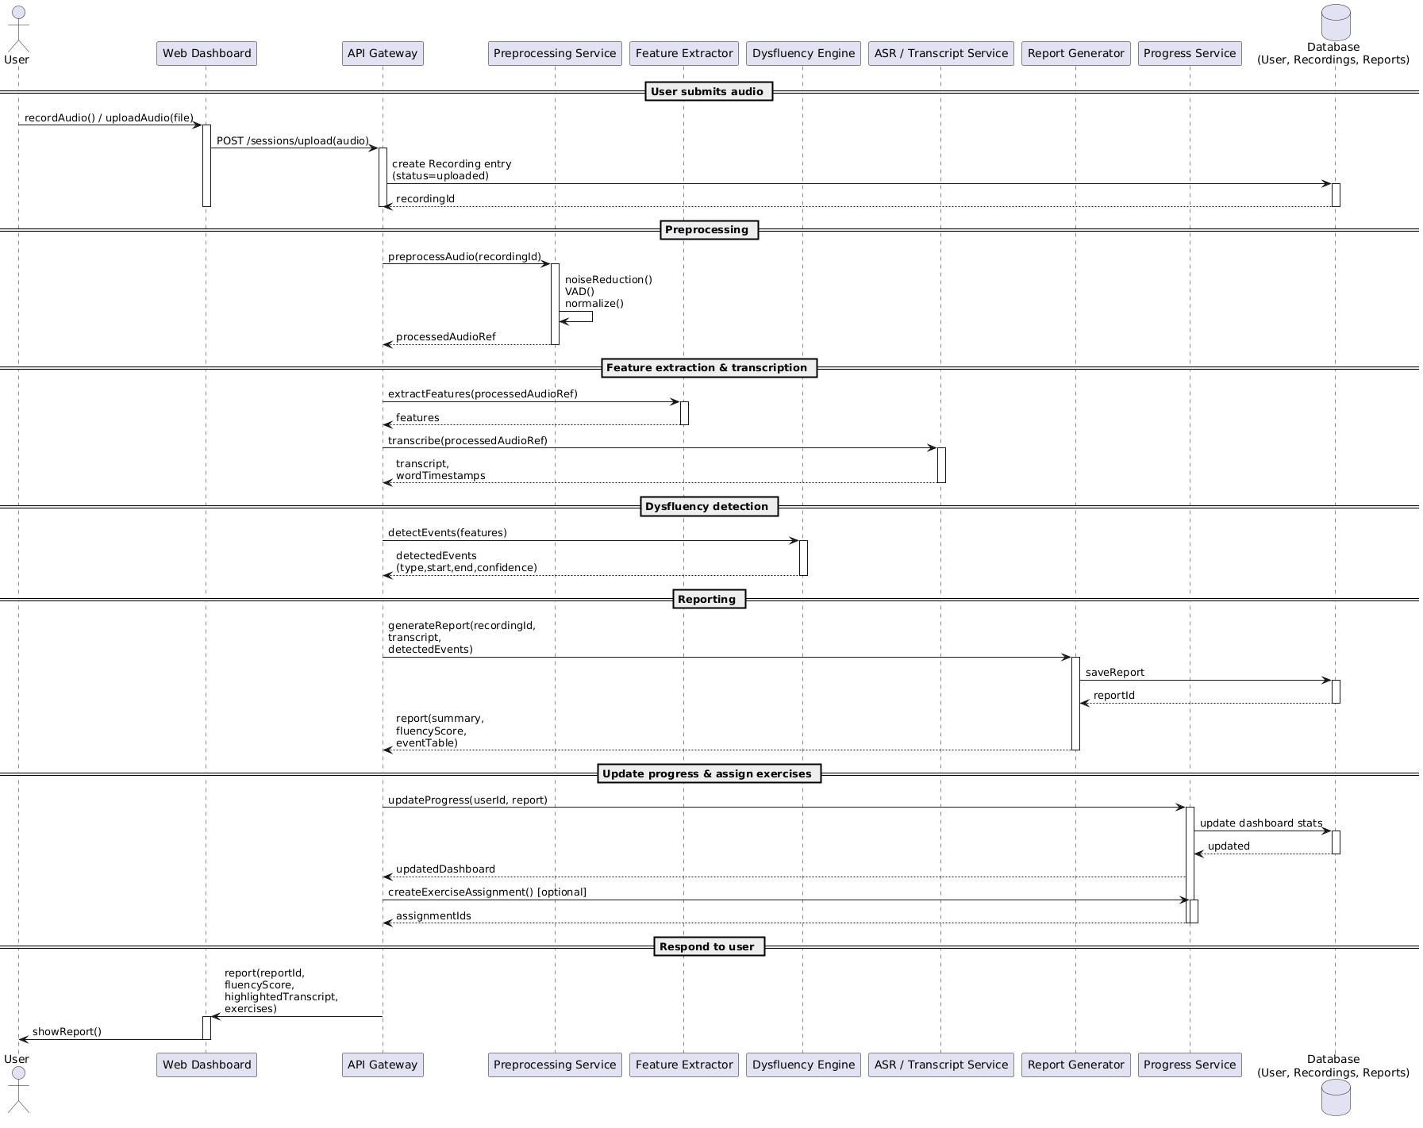
Sequence Diagram
Figure 6: Sequence Diagram

Slide 28
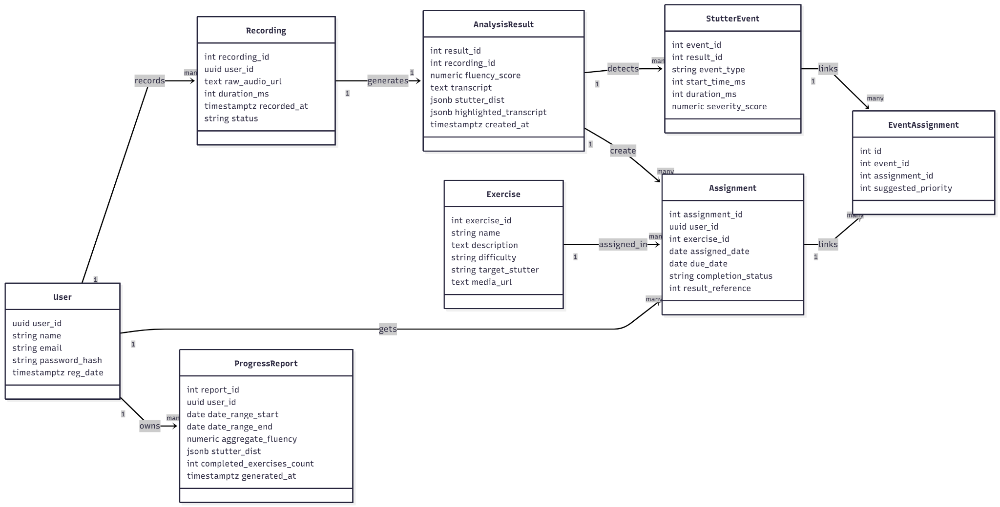
Domain Model
Figure 7: Domain Model

Slide 29
Implementation
Development Tools and Techniques
Languages: Python, JavaScript
ML Frameworks: TensorFlow / PyTorch
Audio Processing: Librosa, PyDub
Backend: DJango / RestAPI
Frontend: HTML, CSS, JavaScript, GSAP / Flutter
Database: Firebase / Mysql / Sqlite
Visualization: Matplotlib, Plotly

Slide 30
Implementation
Best Practices
Write clean, modular code with meaningful names
Add comments & documentation
Handle errors securely
Reuse components/functions
Test code and ensure accessibility
Optimize performance
Libraries & Services
Frontend: React, Redux/Context API, Material-UI/Tailwind, Axios, Firebase Auth, Socket.IO, Jest
Backend: Rest API, Hugging Face/TensorFlow/PyTorch, Pytest
Other Tools: jsPDF/PDFKit (PDF), Sentry/LogRocket (monitoring)

Slide 31
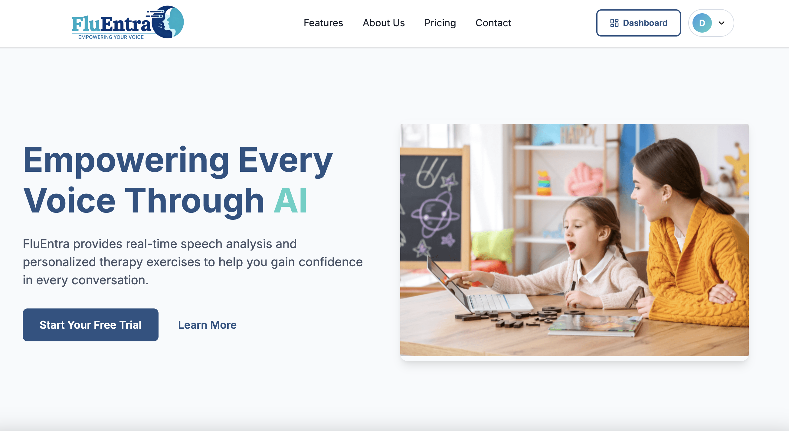
UI/UX DEMO

Slide 32
THANK YOU

